Slide 1
Chemistry – Sept 27, 2019
P3 Challenge –
Classify an apple according to
1) solid/liquid/gas
2) pure substance/mixture
3) element/compound/homogeneous/heterogeneous
When done with P3, study for Element practice quiz. We will do that first.

Slide 2
Objectives and Agenda
Objectives
  To identify physical and chemical properties
  To identify physical and chemical changes
  To learn about ways to separate mixtures
Assignment: Physical and chemical properties and changes worksheet
Agenda:
  Element quiz
  Complete Matter Classification
  Physical properties
  Chemical properties
  Physical changes
  Chemical changes
  Separation methods (time permitting)

Slide 3
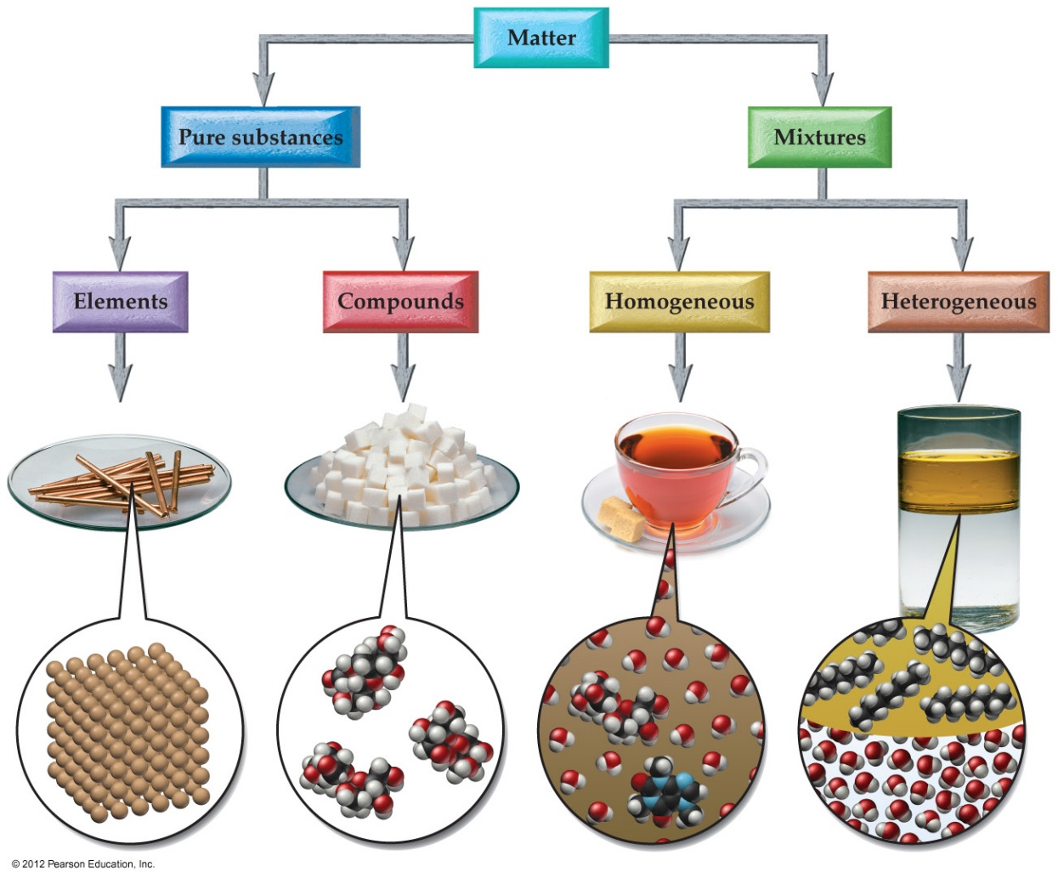
Classification of Matter
Besides identifying the state of matter (solid, liquid, gas) we can also classify matter according to its composition
Distinctions to make
  Mixtures – Pure substances
  Homogeneous – Heterogeneous
  Elements – Compounds

Slide 4
Types of Pure Substances
Mixtures separated by physical means into components are pure substances.
Decompose pure substances using chemical methods: reactivity with other substances, reaction to heat, light or electricity
Element = Pure substance that cannot be broken down into simpler pure substances by any chemical means
Compound = Pure substance that can be broken down into simpler pure substances (other compounds or elements) by chemical means.

Slide 5
Elements
Practice quiz for all 51 Memory elements on 9/24
10 pt quiz for 30 random elements on 9/26
118 known, 91 naturally occurring, 27 synthetic elements
Each element given a one or two letter symbol based on their name in English or Latin (first is capitalized)
Organized on the periodic table
Memorize the symbols for elements with Z ≤ 36 and a few others that are common: Zr, Ag, Sn, Sb, I, Xe, Ba, W, Pt, Au, Hg, Pb, Rn, U, Pu
Remember, the symbol applies to both a single atom and a macroscopic sample of the element

Slide 6
Compounds
Compounds are either crystalline or amorphous (salt/molecule, inorganic/organic)
Law of constant composition / definite proportions
  All samples of a given compound contain exactly the same proportion of elements by mass.
Organic Compounds far outnumber Inorganic Compounds even though they only involve a relatively few kinds of elements
  Organic compounds typically contain C, H, O, and/or N

Slide 7
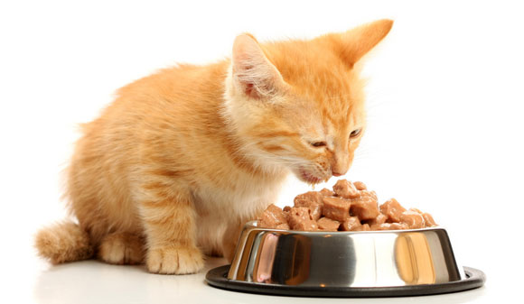
Properties of Matter
Properties distinguish one pure substance from another
Physical Properties = characteristics of a substance that do not change its identity
  State (solid, liquid, gas)
  Melting point, boiling point
  Color, odor, taste, hardness, viscosity, electromagnetic behavior
  Density, mass, volume

Slide 8
Properties of Matter
Chemical Properties = characteristics of a substance that describe how its identity changes
  Reactivity with other substances
    Ex: Reactions with air or water, flammability, toxicity
  Stability under certain conditions
    Ex: Radioactivity, thermal stability

Slide 9
Properties of Matter
Extensive properties depend on how much of the substance is present.
  Ex: mass, moles, volume, length, toxicity
Intensive properties are the same regardless of how much of the substance is present.
  Ex: state, density, boiling point, melting point, molar mass, temperature, hardness, color, odor, taste, heat capacity, elasticity, conductivity, radioactivity, flammability

Slide 10
Changes in Matter
Physical Change = a process that changes a substance’s physical properties but not its chemical identity
  change of state
  forming or separating mixtures
Chemical Change = a process that changes a substance’s chemical identity
  chemical reaction reactants → products
Only an examination of the substances before and after a change can verify whether the change is physical or chemical.

Slide 11
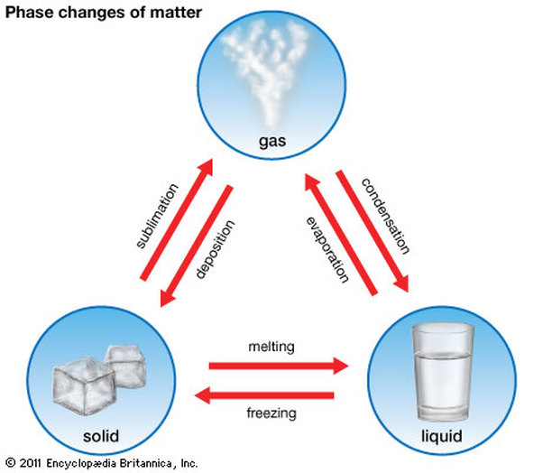
Changes of State
Melting point (m.p.) or freezing point
  temperature at which a substance changes from solid to liquid
Boiling point (b.p) or condensation point
  temperature at which a substance changes from liquid to gas

Slide 12
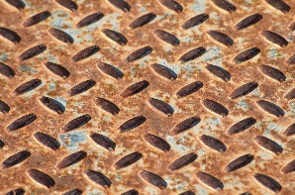
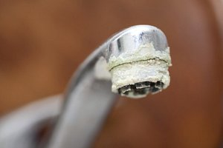
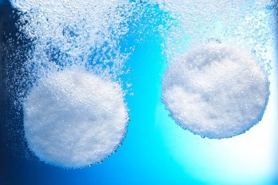

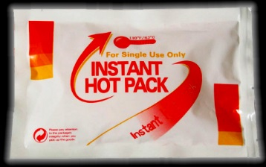
Evidence of a possible chemical reaction/change
Color change (ex: rust formation)
Formation of a solid (ex: hard water deposits)
Formation of a gas (ex: Alka Seltzer)
Emission of light (ex: fireworks)
Spontaneous exchange of heat (heats up or cools down) (ex: hot/cold packs)
These five observations usually indicate a chemical change
Note: Phase changes may also involve the formation of a solid or a gas,
  Physical state changes due to heat addition/subtraction
  Chemical state changes due to mixing different substances

Slide 13
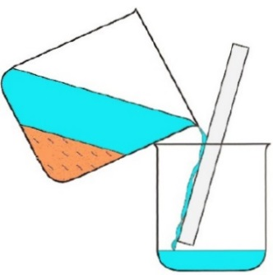
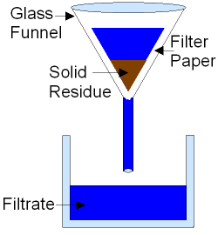
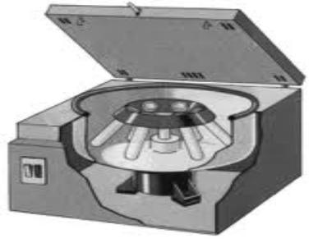
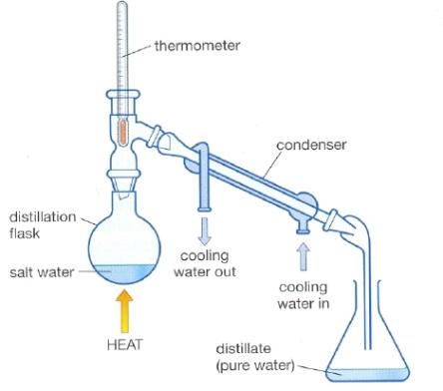
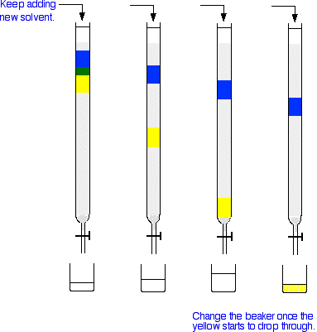
Mechanical Means of Separation
Decantation (separates a solid from a liquid or two liquids based on density)
Filtration (separates a solid from a liquid based on particle size)
Centrifugation (separates a solid from a liquid or two liquids based on density)
Distillation (separates two liquids based on boiling point)
Chromatography (separates any two substances based on affinity for a support substance)

Slide 14
Exit Slip - Homework
Exit Slip: List three physical properties of an apple and one chemical property.
What’s Due? (Pending assignments to complete.)
  Physical and chemical properties and changes worksheet
What’s Next? (How to prepare for the next day)
  Separation Lab on Monday. (Do you best not to miss this day.)

